Slide 1
Progress 27 Feb 2019
AD

Slide 2
The Interplanetary Magnetic Field (IMF) is a part of the sun’s magnetic field which is drifted in space (by solar wind) towards the earth and is detected by our satellites which are in orbit around at the distance where E_{g} = S_{g}.
Because the sun rotates once roughly every 27 days, the IMF creates a spiral pattern, like a water sprinkler on a lawn.
Thus, depending on the orientation of the IMF, the solar wind interacts with the Earth’s magnetosphere, creating storms, auroras, etc.

Slide 3
A ring current is an electric current in the earth’s equatorial plane (at around 4 to 8 R_{E}) caused due to ions in the earth’s magnetosphere.
These ions in the ring current are responsible in producing a magnetic field opposite to the Earth’s magnetic field. Thus, this potential decrease in the Earth’s magnetic field at the equator is measured by Dst index.
Basically, Disturbance Storm Time (or Dst) measures the strength of the Ring Current.

Slide 4
Dst measures undergo radical changes during geomagnetic storms. After the sun’s activities transfer energy via the IMF to the ring current, there is a change in the ring current densities.
A Sudden Storm Commencement (SC) showcases a sudden rise in Dst, followed by the recovery period, where the Dst recovers slowly back to normal ranging from 5 - 15 days.
It is important to keep in mind the Dst measures at its peak when it is at its most negative, corresponding to the abnormally low Earth’s magnetic field at the equator.

Slide 5
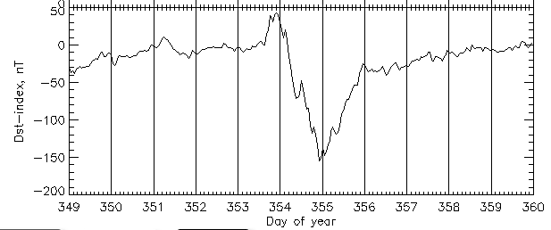
Following are the Dst measures (from most recent to oldest) for geomagnetic events - 1) 2015, Dec 15 to Dec 25
SC
Recovery Phase

Slide 6
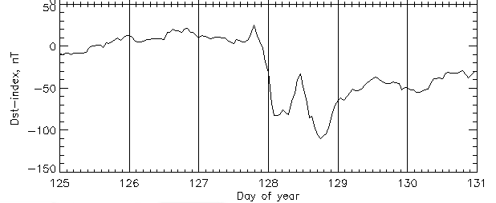
2) 2005, May 05 to May 10

Slide 7
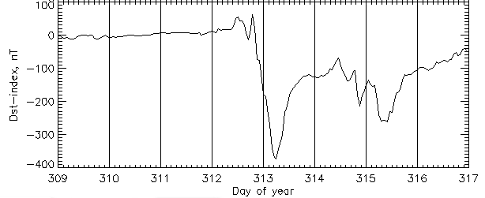
3) 2004, Nov 04 to Nov 11

Slide 8
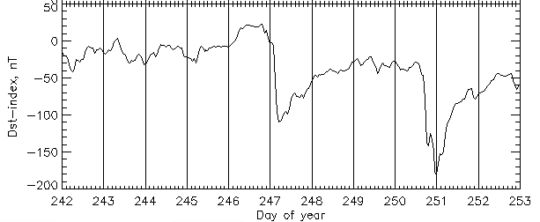
4) 2002, Aug 30 to Sept 09

Slide 9
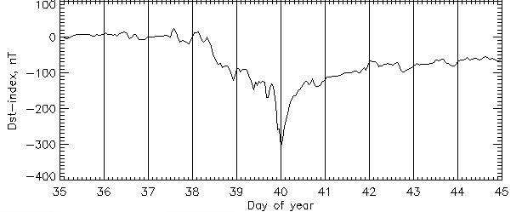
4) 1986, Feb 04 to Feb 13

Slide 10
Further Questions
How are magnetic fields formed in astronomical bodies like the sun or Earth? Do other planets have magnetic fields?
I am not able to understand how exactly the transfer of energy from solar winds to Earth’s magnetic field takes place. The term for it is “magnetic reconnection.”

Slide 11
Fin

